Slide 1
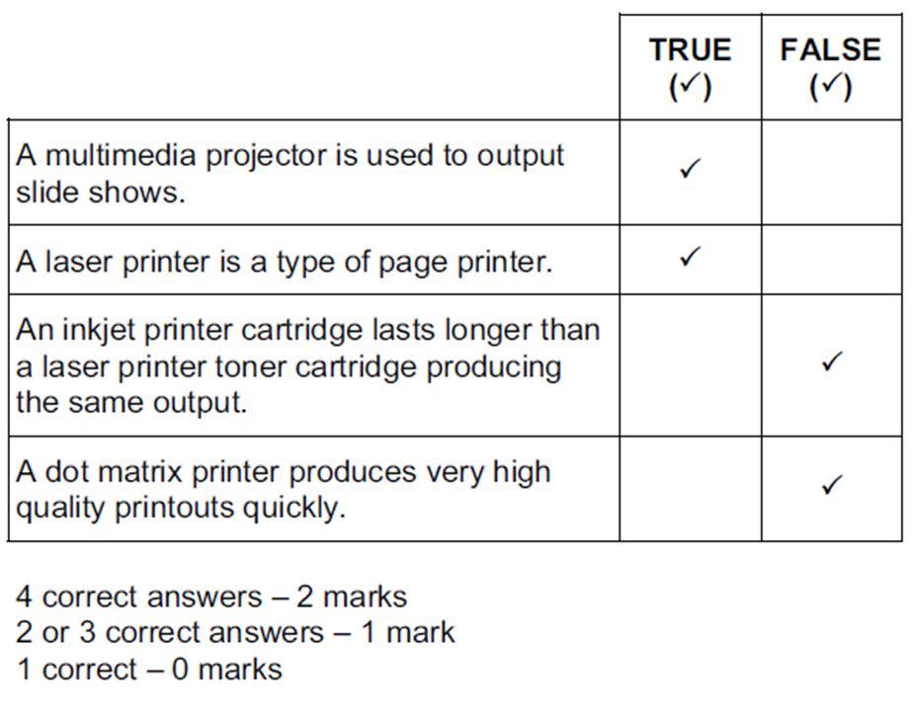
Tick whether the following statements about output devices are true or false.

Slide 2
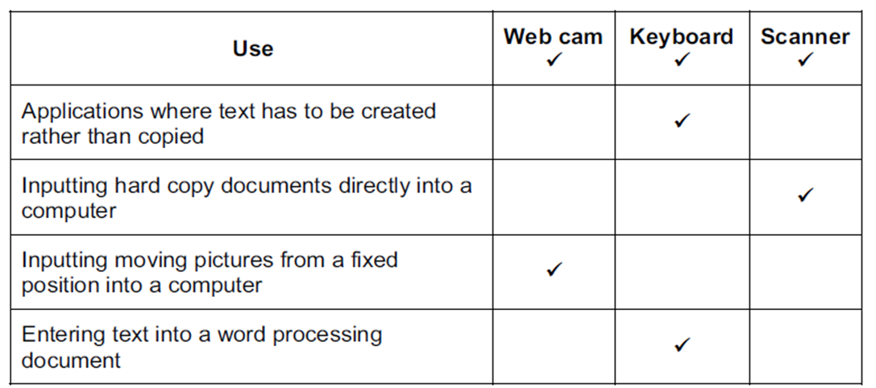
Tick the most appropriate method of inputting data for the following uses.

Slide 3
The inbuilt device which moves the cursor when using a laptop is called a touch pad.
The device used for selecting an icon so a bar code label can be printed in a supermarket is called a touch screen.
The device used for controlling a pointer on a screen when the user has limited motor skills is called a trackerball.
This is provided with a laptop to imitate the functions of a mouse.
Touchpad
This is not a mouse but is used to manoeuvre objects around the screen in computer video games.
Joystick
This is used to type in text.
Keyboard
This is used for direct input of hard copy images.
Scanner

Slide 4
Data can be input to a computer using direct data entry methods.
Write down the most appropriate device to input the following:
(a) information from the chip in an electronic passport
RFID reader
(b) text from an id card
Optical Character Reader
(c) account details from the front of a credit card at an EFTPOS terminal
Chip reader
(d) account details from the back of a credit card at an EFTPOS terminal
Magnetic stripe reader

Slide 5
Data can be input to a computer using different devices.
Write down the most appropriate input device which will enable you to:
(a) type an essay
Keyboard
(b) select options from a drop down menu whilst moving the device
Mouse
(c) read the temperature
Temperature sensor
(d) fly an aircraft in a video game.
Joystick

Slide 6
Describe how MICR is used to read these details from the cheque.
Requires a special Magnetic Ink Character reader/scanner/Details are scanned
The magnetic ink on the cheque passes over a magnet in the reader/scanner which charges/magnetises the ink
The MICR reader/scanner then reads the magnetic signal given out by the magnetic ink characters on the cheque.
Each character produces a unique signal which is read and translated by the MIC reader

Slide 7
Discuss why different user interfaces require the use of different types of input devices.
With a GUI you just click on an icon
With a GUI icons represent applications
Separate windows are used for different pieces of work/software
With a GUI menus are offered to help choose an action
Moving a mouse enables users to manoeuvre a pointer around a screen
A mouse can be used to drag windows/icons around a screen
People with physical disabilities can use a trackerball to manoeuvre the pointer around a screen
Pointing devices are easier to control a pointer/menu selection/icon clicking
Joysticks can be used to mimic the behaviour of a mouse
Buttons on the mouse enable users to select icons
Buttons on a mouse enable users to see menus on a screen
Touchscreen can be used to directly select options from a screen

